Slide 1



Health Nutrition and Population Statistics
by Mehmet Ozkemah
Thinkful Data Science Flex Program
Capstone Project 2

Slide 2
Table of Content
SLIDE 3
PROJECT OVERVIEW
SLIDE 4
DATASET IN A NUTSHELL
SLIDES 5
TARGET VARIABLE ANALYSIS
SLIDES 6-7
FEATURE ANALYSIS
SLIDES 8
MODEL EQUATION
SLIDES 9-12
DATA CLEANING
SLIDES 13-15
DATA EXPLORATION
SLIDES 16-18
FEATURE ENGINEERING
SLIDES 19-25
MODELING
SLIDES 26-27
COMPARING THE MODELS
SLIDES 28
WINNER MODEL

Slide 3

Project Overview
To Reach Metadata Glossary
Data Source
Data
Shape
To Reach Data
88 Columns
2,300 Rows
https://databank.worldbank.org/source/health-nutrition-and-population-statistics/preview/on#
https://databank.worldbank.org/metadataglossary/Health-Nutrition-and-Population-Statistics/series,country

Slide 4
Dataset in a Nutshell
Variable Types
Target Variable
Final Features
Data Type
Death Rate
(le_sp_dyn_cdrt_in)
3 categorical object
1 datetime
84 float
* Population ages 65 and above
* Life expectancy at birth, male
* Mortality rate, infant
Time Series
Yearly data
from 2000-2010
230 countries
https://datacatalog.worldbank.org/death-rate-crude-1000-people-0#:~:text=Crude%20death%20rate%20indicates%20the,1%2C000%20population%20estimated%20at%20midyear.&text=World%20Population%20Prospects%3A%202019%20Revision
https://datacatalog.worldbank.org/search?search_api_views_fulltext_op=AND&query=population%20ages%2065%20and%20above&nid=&sort_by=search_api_relevance&sort_order=DESC

Slide 5
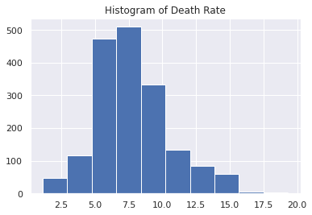
Target Variable Analysis
Death Rate
Histogram of Death Rate (follows normal distribution)
Descriptive Statistics of Death Rate
Skewness & Kurtosis
 | Values
Count | 1,768
Mean | 7.786
Std | 2.779
Min | 1.127
25% | 5.917
50% | 7.367
75% | 9.400
Max | 19.325
Skewness | Kurtosis
0.62 | 0.55
They both are in normal range
https://www.smartpls.com/documentation/functionalities/excess-kurtosis-and-skewness

Slide 6
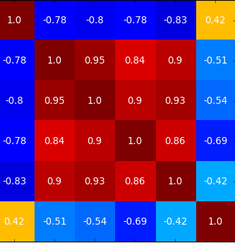



Feature Analysis
How to Decide Features?
1
2
87 Columns
34 Columns
Drop the columns that have more than 30% values missing
Correlation Matrix with 0.25 threshold
3
Performance of high correlated features analyzed by trial and error method

Slide 7
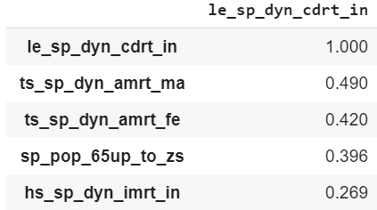
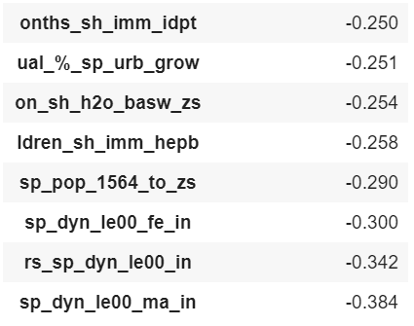
Feature Analysis
Correlation Matrix
Highest positive correlated features with target value Threshold=0.25
Highest negative correlated features with target value Threshold=0.25

Slide 8


Model Equation
Death Rate
Population ages 65 and Above
Mortality Rate, Infant
Life Expectancy at Birth Male
sp_pop_65up_to_zs
hs_sp_dyn_imrt_in
sp_dyn_le00_ma_in

Slide 9

Exploratory Data Analysis
MODELING Compare the models &
Select the right model.
4
DATA CLEANING Detect the problems with the data and eliminate them.
1
3
FEATURE ENGINEERING Select, modify or create useful features.
DATA EXPLORATION Explore and understand the data.
2

Slide 10

Exploratory Data Analysis
1
1
Data Cleaning

Slide 11
Exploratory Data Analysis
Data Cleaning
Handling with messy column names
Dropping unneeded columns
Data type change
Detecting and handling missing values
defined threshold for columns & applied interpolation method
Detecting and treating outliers
Zscore for detecting the outliers
Winsorization for limiting the effects of outliers
1
1

Slide 12
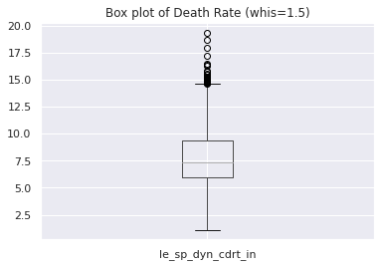
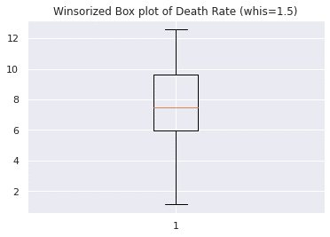
Exploratory Data Analysis
Data Cleaning / Box plot of target variable death rate
Boxplot Before Winsorization
Boxplot After Winsorization
No outliers after winsorization

Slide 13

Exploratory Data Analysis
2
Data Exploration

Slide 14
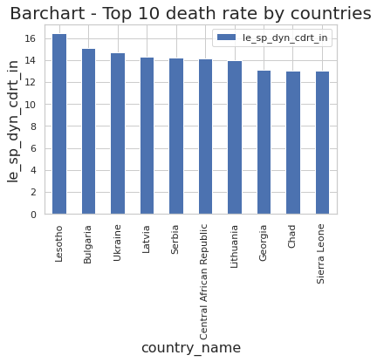
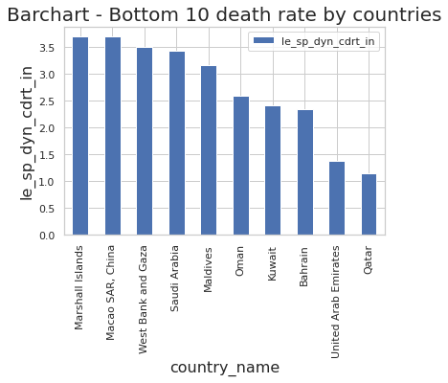
Data Exploration
Top 10 and Bottom 10 Death Rates by Countries
Why Bulgaria is one of the top countries with the highest death rate?
Why Gulf countries have the lowest death rate?
https://www.bnr.bg/en/post/101234540/bulgaria-is-the-country-with-highest-mortality-rate#:~:text=Like%20in%20the%20rest%20of,non%2Dinfectious%20and%20cancer%20diseases.&text=The%20countries%20with%20high%20mortality,are%20facing%20a%20demographic%20collapse.
https://www.prb.org/populationtrendsandchallengesinthemiddleeastandnorthafrica/240/

Slide 15
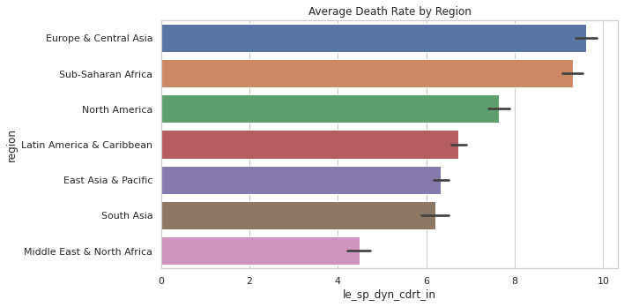
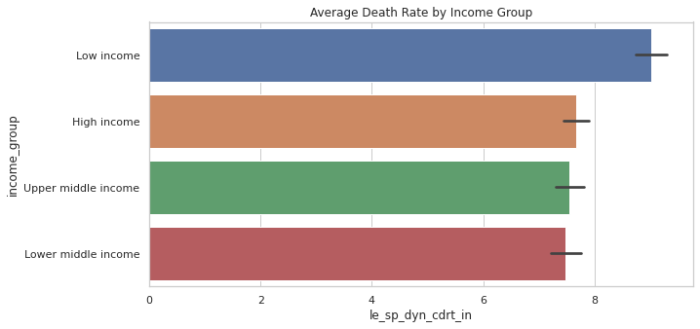
Data Exploration
Average Death Rate by Region and Income Group
Europe&Central Asia and Sub-Saharan Africa have the highest death rate.
It is due to older population ratio and lower birth rate for Europe & Central Asia and lower quality healthcare and higher infant mortality for Sub-Saharan countries.
https://www.ined.fr/en/everything_about_population/data/europe-developed-countries/birth-death-infant-mortality/

Slide 16

Exploratory Data Analysis
3
Feature Engineering

Slide 17
Exploratory Data Analysis
3
Feature Engineering
Threshold method used to reduce the number
2 categorical features imported to dataset
Region and income group
Winsorization, Log transformation and Box-cox transformation methods applied to deal with non normality
Standard Scaler method applied for standardization
Transformation of values provided with Eigenvalues and Eigenvectors

Slide 18
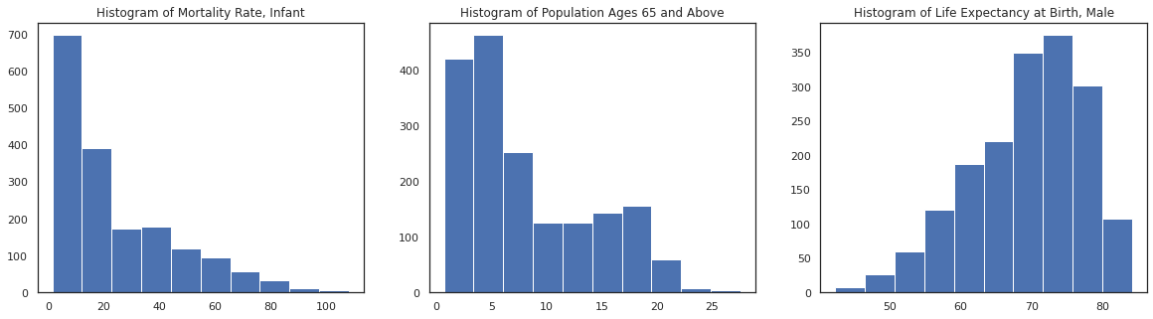
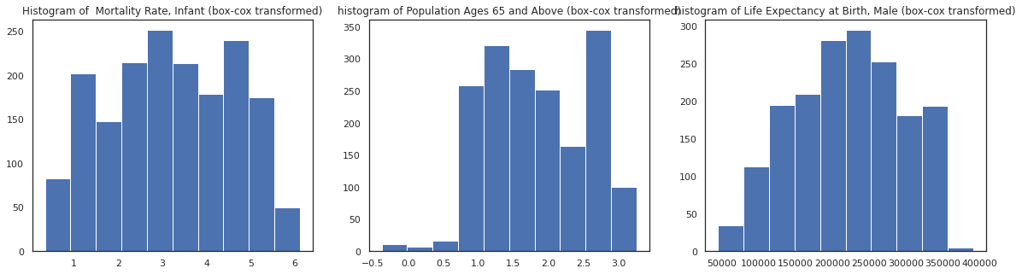
Exploratory Data Analysis
Feature Engineering / Histogram of Features
Population ages 65 and Above
Life Expectancy at Birth Male
Mortality Rate, Infant
Before
After
Winsorization, Log transformation and Box-cox transformation

Slide 19

Exploratory Data Analysis
4
Modeling
1
3
2

Slide 20
Modeling
Five model performed and compared their results
Simple Linear Regression with OLS
Support Vector Machine
Decision Tree
Random Forest Regression
Gradient Boosting
4
1
3
2

Slide 21
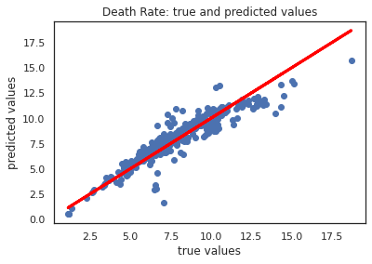
1.Simple Linear Regression with OLS
Simple Linear Regression with OLS | Scores
R^2 | 0.84
Root Mean Squared Error | 0.97
Mean Absolute Error | 0.68
Cross Validation Score Mean | 0.82
Cross Validation Score Std | 0.08
Death Rate
0.53
*
Population ages 65 and above
0.01
*
Mortality rate, infant
0.35
*
Life expectancy at birth, male
27.67

Slide 22
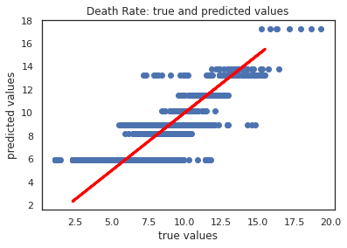
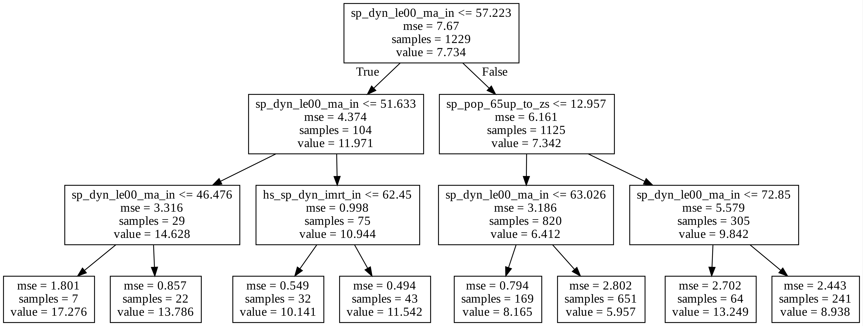
2.Decision Tree Regression
Decision Tree Regression | Scores
R^2 | 0.61
Root Mean Squared Error | 1.60
Mean Absolute Error | 1.20
Cross Validation Score Mean | 0.55
Cross Validation Score Std | 0.09

Slide 23
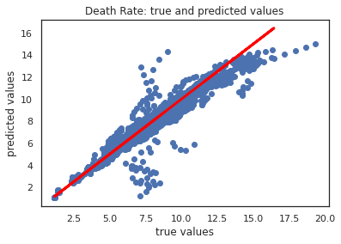
3.Support Vector Machine
Support Vector Machine | Scores
R^2 | 0.85
Root Mean Squared Error | 1.09
Mean Absolute Error | 0.67
Cross Validation Score Mean | 0.85
Cross Validation Score Std | 0.07

Slide 24
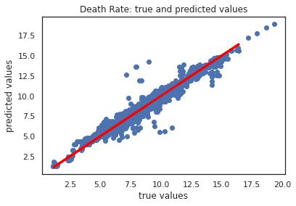
4.Gradient Boosting
Gradient Boosting | Scores
R^2 | 0.91
Root Mean Squared Error | 0.84
Mean Absolute Error | 0.52
Cross Validation Score Mean | 0.86
Cross Validation Score Std | 0.07

Slide 25
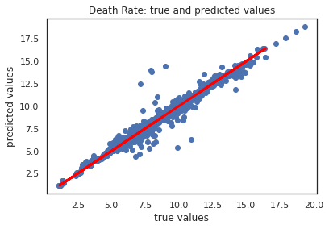
5.Random Forest Regression
Random Forest Regression | Scores
R^2 | 0.92
Root Mean Squared Error | 0.78
Mean Absolute Error | 0.41
Cross Validation Score Mean | 0.85
Cross Validation Score Std | 0.08

Slide 26
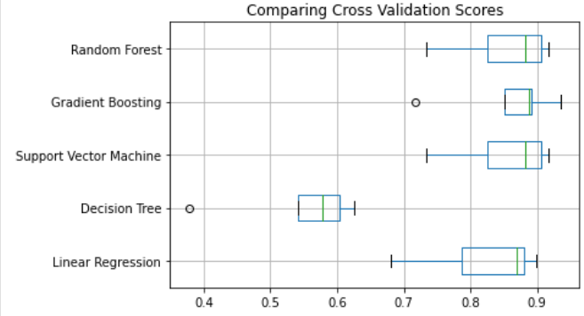
Model Comparison
Comparison of Cross Validation Scores

Slide 27

Model Comparison
Models | R^2 | Root Mean Squared Error | Mean Absolute Error | Cross Validation Score Mean | Cross Validation Score Std
Simple Linear Regression with OLS | 0.84 | 0.97 | 0.68 | 0.82 | 0.08
Decision Tree Regression | 0.61 | 1.60 | 1.20 | 0.55 | 0.09
Support Vector Machine | 0.85 | 1.09 | 0.67 | 0.85 | 0.07
Gradient Boosting | 0.91 | 0.84 | 0.52 | 0.86 | 0.07
Random Forest | 0.92 | 0.78 | 0.41 | 0.85 | 0.08

Slide 28
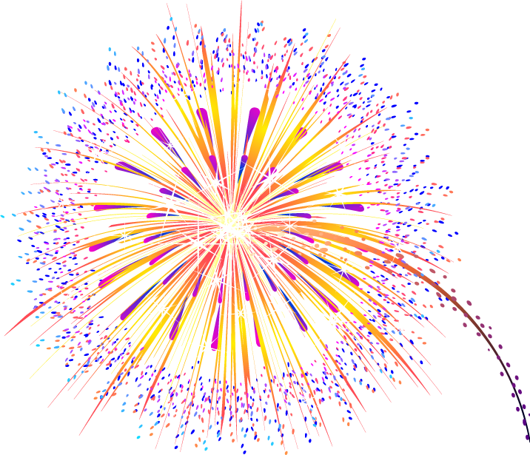


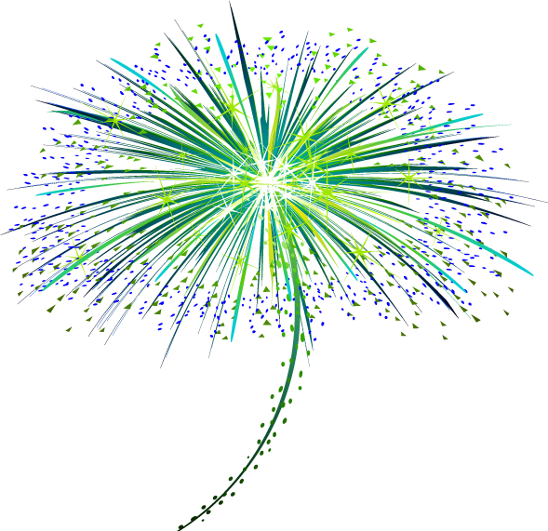





Winner is RANDOM FOREST MODEL

Slide 29
Final Decision
“
Each model has some pros or cons.
However based on the features I choose and the analysis I run accordingly Random Forest is the best performer to explain death rate.
The predictive performance of Random Forest Model is always on top and it also provides a reliable feature importance estimate.
What might be the weakness of Random Forest Models?
They are less interpretable than an individual decision tree and the predictions are slower.
“

Slide 30

ANY QUESTIONS?

